Slide 1
Churn rate - Telco SA
A data exploratory analysis
for response the business hypothesis.

Slide 2
Summary
Descriptive analysis
Multivariate analysis
Pearson correlation in numeric variables
Phik correlation
Cramer V correlation
Bivariate analysis
Categorical barplots
Univariate analysis
Distribution plots with numerical variables
Highlights
Response business hypothesis
Churn customers who have a monthly contract are the majority !
Churn customers who are married are the majority!
Churn customers who have phone service are the majority!
Churn customers who do not have Device Protection are the majority!
Churn customers who have a Payment Method such as Electronic Check are the majority!

Slide 3
Multivariate analysis
Pearson correlation in numerical variables: In descriptive statistics, Pearson's correlation coefficient, also called "product-momentum correlation coefficient" or simply "Pearson's ρ" measures the degree of correlation between two metric scale variables. This coefficient, normally represented by ρ, only takes on values ​​between -1 and 1.

Slide 4
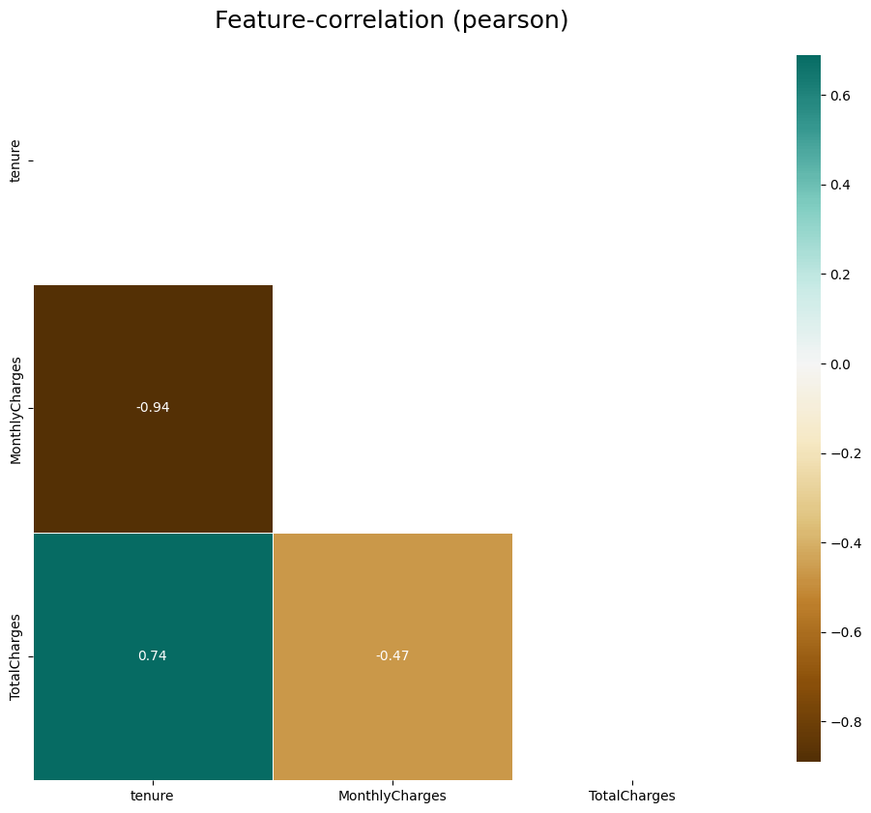
Pearson correlation in numerical variables:
- TotalCharges is correlated with tenure, the number of tenure impact in total cust
- MonthlyCharges is correlated with TotalCharges, both motive the tenure

Slide 5
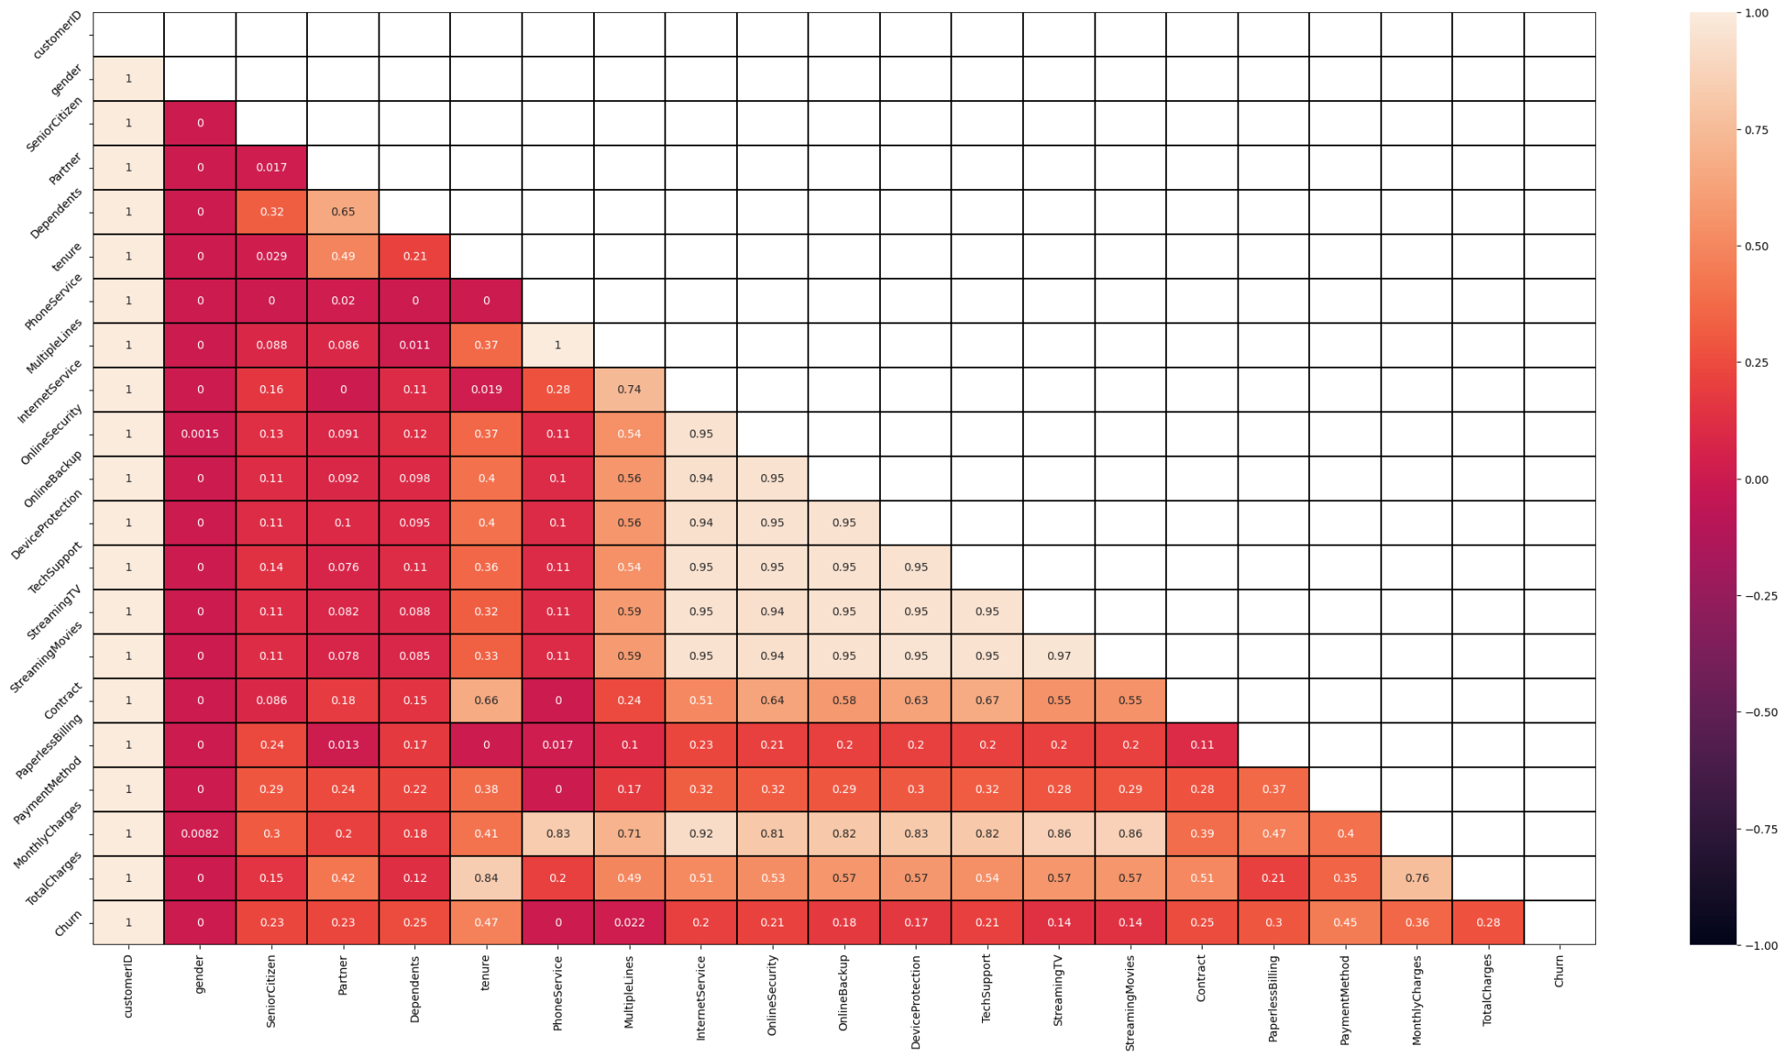
Phik correlation
- The combined features of Phi_K form an advantage over existing coefficients.
- First, it works consistently between categorical, ordinal and interval variables. Second, it captures non-linear dependency.
- Third, it reverts to the Pearson correlation coefficient in case of a bi-variate normal input distribution.
- These are useful features when studying the correlation matrix of variables with mixed types.

Slide 6
Phik correlation in all variables:
- So what: List of variables contains positive correlation with target (Churn) variable
tenure;
paymentmetody;
monthlyCharges;
paperlessbilling;
TotalCharges;
contract;
Dependents;
partner;
SeniorCitizen;
OnlineSecurity;
TechSupport;
InternetService;
OnlineBackup;
DeviceProtection;
StreamingTV;
StreamingMovies.

Slide 7
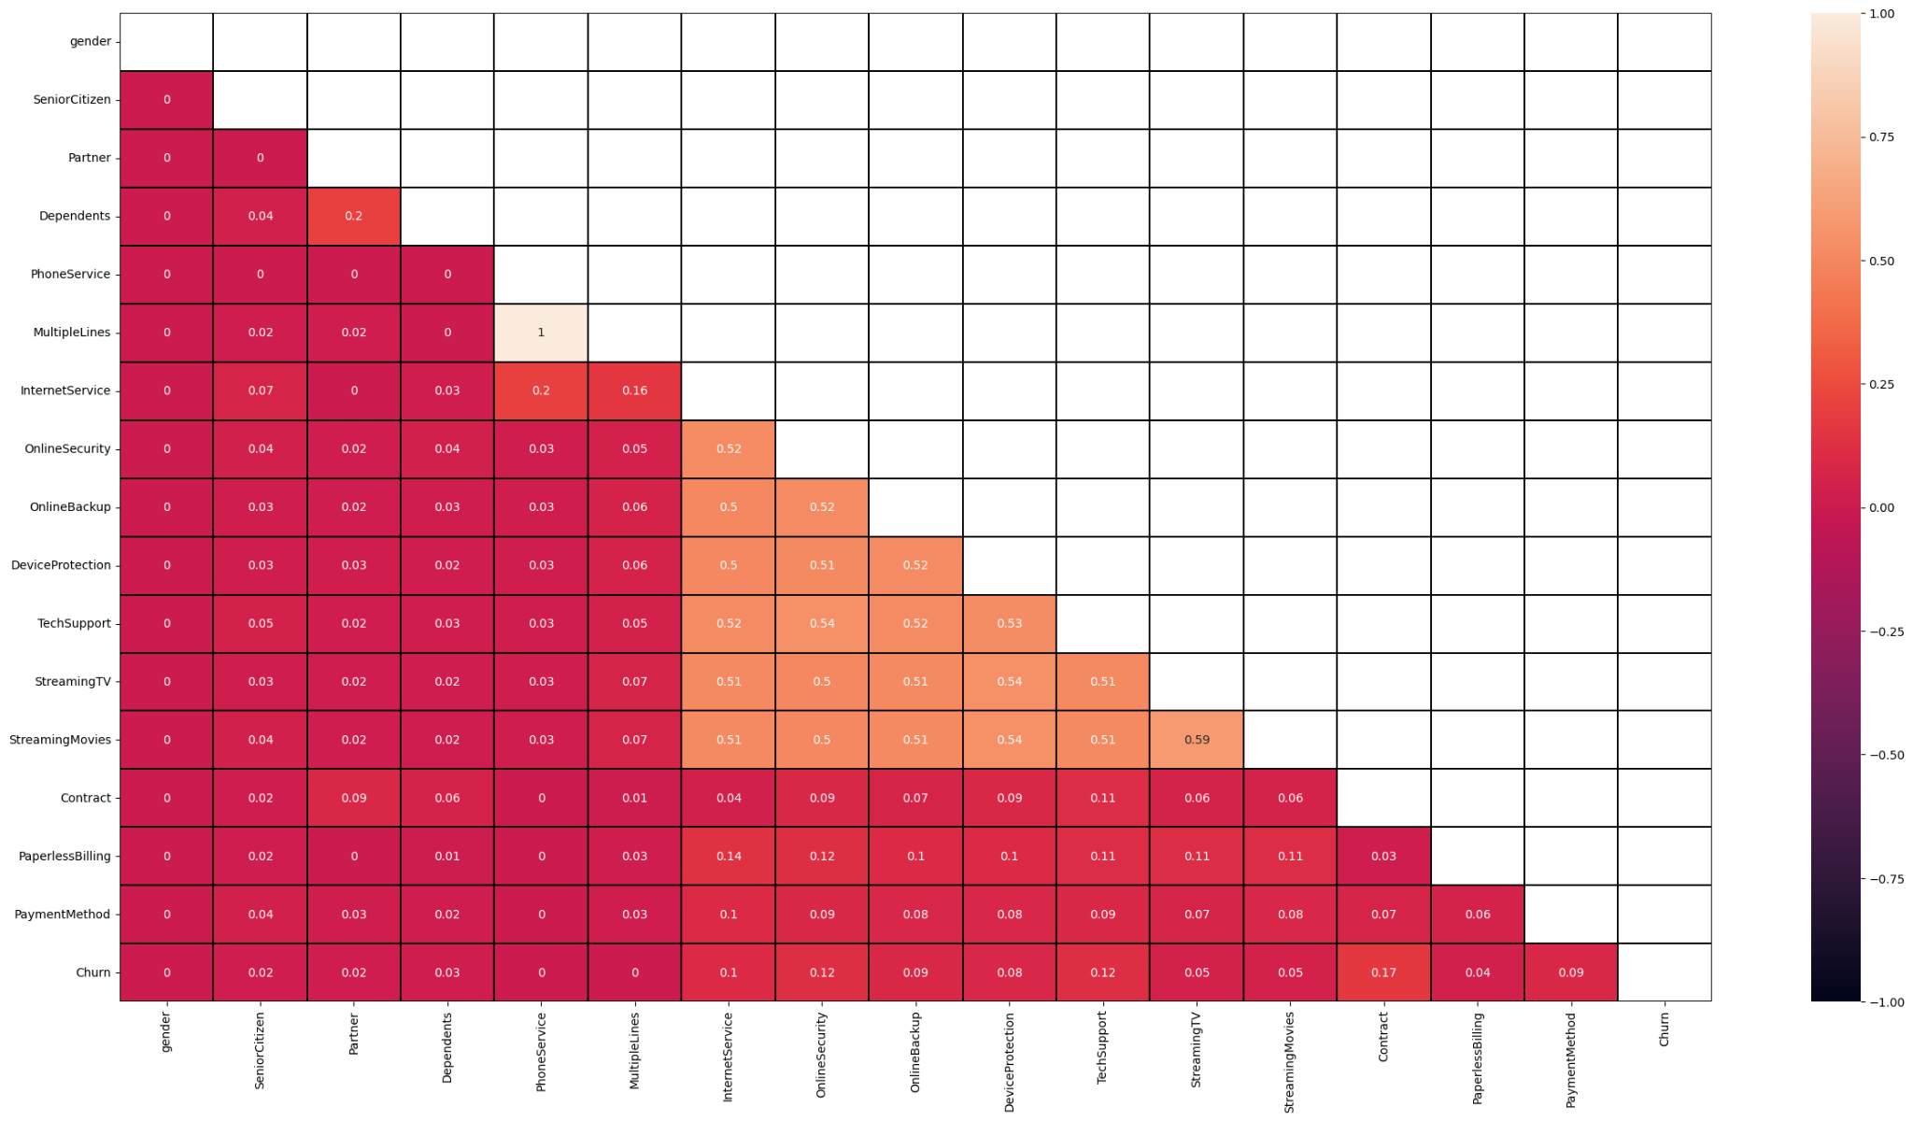
Cramer V analysis
Is a measure of association between two **nominal variables**, giving a value between 0 and +1 (inclusive). It is based on Pearson's chi-squared statistic

Slide 8
Cramer V analysis
- So what of analysis with focus on Churn variable:
Contract haves 0.17 cramer v assosiation
TechSupport and OnlineSecurity haves 0.12 cramer v assosiation
PaymentMethod haves 0.09 cramer v assosiation

Slide 9
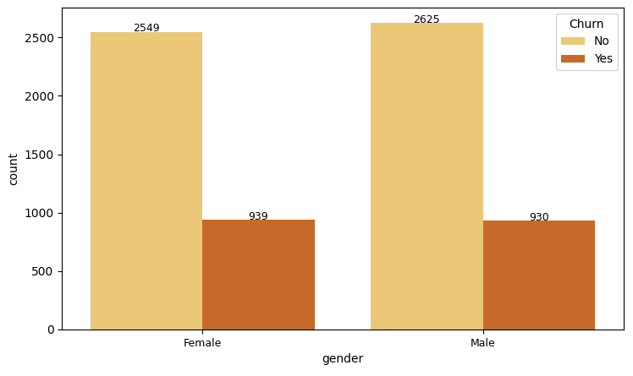
Bivariate analysis
- The churn from gender is balanced !

Slide 10
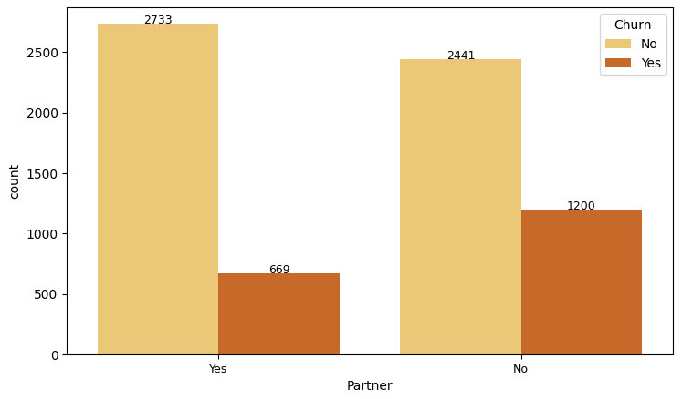
Bivariate analysis
- No partner is most frequente to Churn

Slide 11
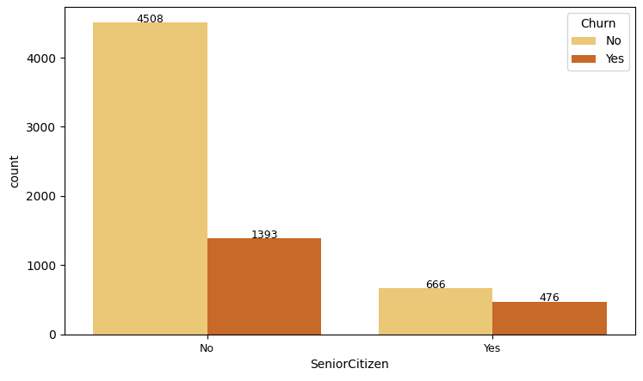
Bivariate analysis
- More frequent churn when peoples not is SeniorCitizen

Slide 12
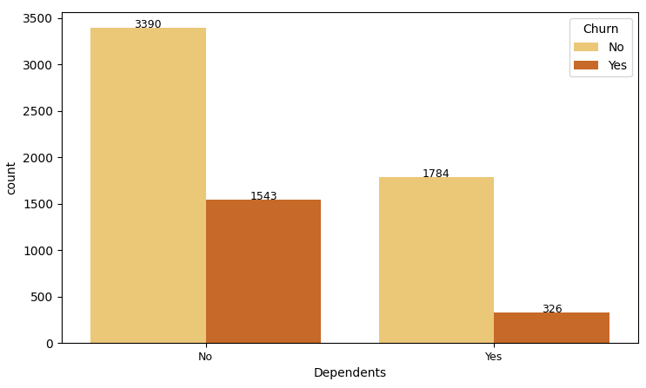
Bivariate analysis
- No Dependents is most frequent to churn

Slide 13
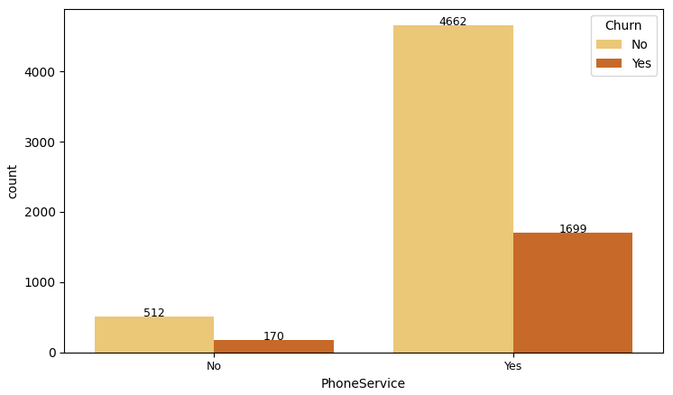
Bivariate analysis
- For those who have PhoneService, Churn is more frequent

Slide 14
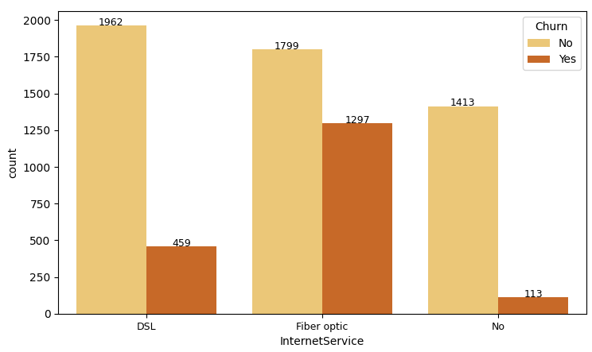
Bivariate analysis
- More frequent churn when InternetService is fiber optic

Slide 15
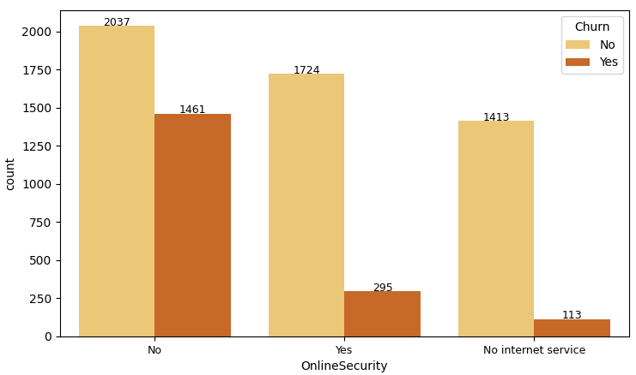
Bivariate analysis
- More frequent churn when peoples not have a OnlineSecurity

Slide 16
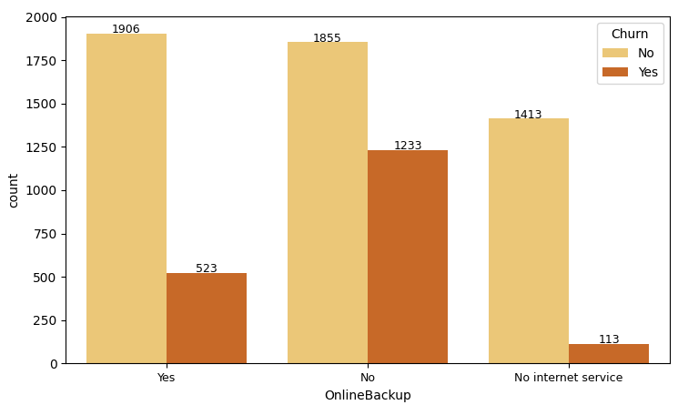
Bivariate analysis
- More frequent churn when peoples not have a OnlineBackup

Slide 17
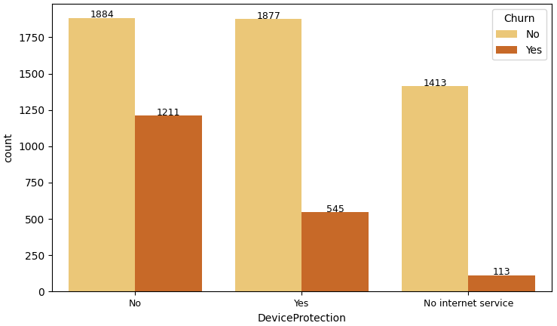
Bivariate analysis
- More frequent churn when peoples not have a DeviceProtection

Slide 18
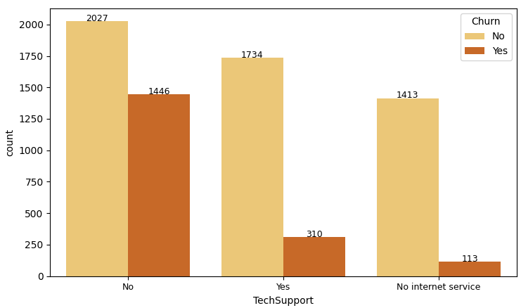
Bivariate analysis
- More frequent churn when peoples not have a TechSupport

Slide 19
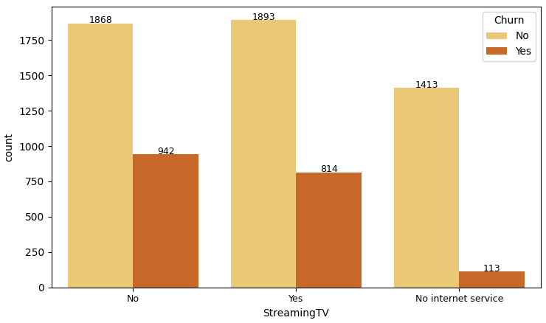
Bivariate analysis
- More frequent churn when peoples not have a StreamingTV

Slide 20
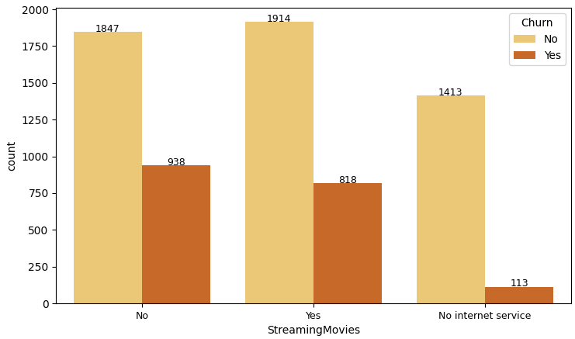
Bivariate analysis
- More frequent churn when peoples not have a StramingMovies

Slide 21
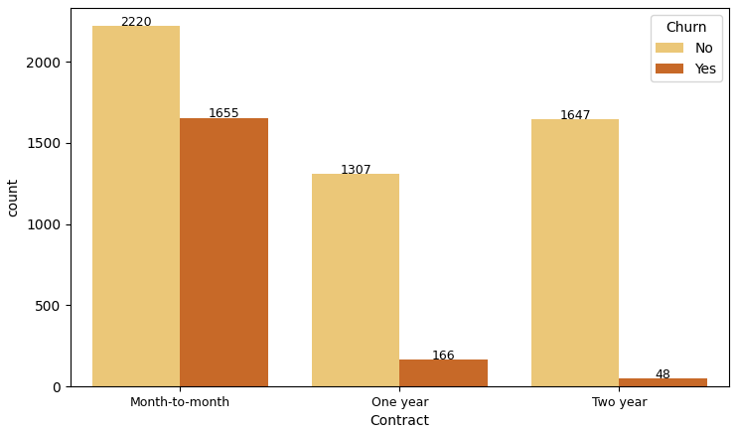
Bivariate analysis
- More frequent churn when peoples have a Contract Month-to-month

Slide 22
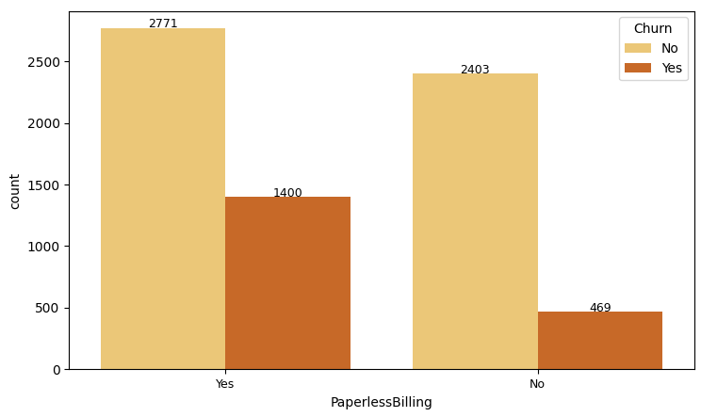
Bivariate analysis
- More frequent churn when peoples have a PaperlessBilling

Slide 23
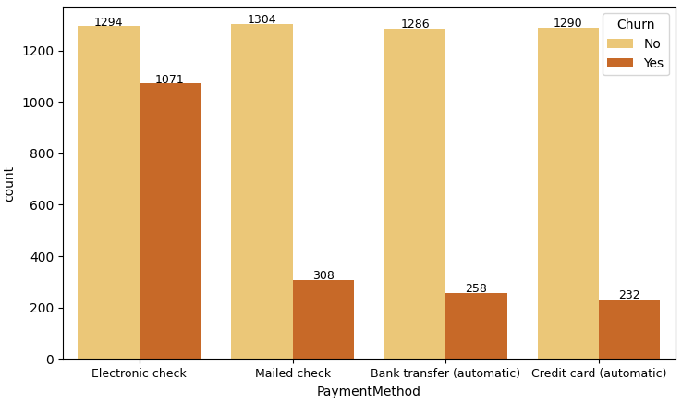
Bivariate analysis
- More frequent churn when peoples have a Electronic check how PaymentMethod

Slide 24
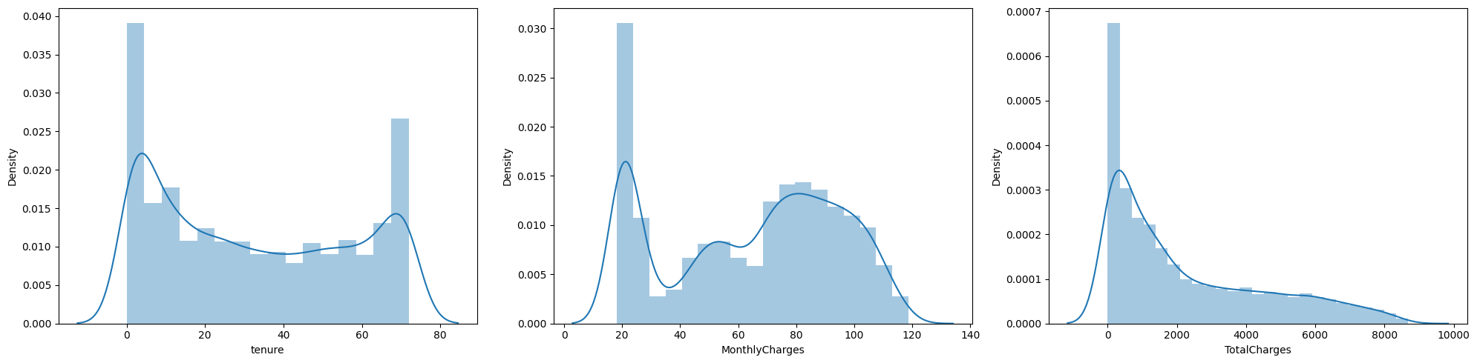
Univariate analysis
- So what numerical variables
tenure and MonthlyCharges kind of create a bimodal distribution with peaks present at 0 - 70 and 20 - 80 respectively.
TotalCharges displays a positively exponential distribuition and most frequent total charges are from values ​​around 0 to 1000 dollars

Slide 25
Univariate analysis
- Highlights
Churn customers are a minority and therefore comprise a smaller number of products in possession
Churn customers have a higher average cost of monthly charges
Churn customers have a lower total cost, but their minimum cost exceeds that of non-churn customers

Slide 26
Response business hypothesis
Churn customers who have a monthly contract are the majority !
Yes, true hypothese ! Month-to-month contract represent 88% of churn !

Slide 27
Response business hypothesis
Churn customers who are married are the majority!
No, false hypothese ! the Partner represent 35% of Churn

Slide 28
Response business hypothesis
Churn customers who have phone service are the majority!
Yes, true ! the customer churn have phone service represent 90%

Slide 29
Response business hypothesis
Churn customers who do not have Device Protection are the majority!
Yes, true ! Churn customers who do not have Device Protection represent 64%

Slide 30
Response business hypothesis
Churn customers who have a Payment Method such as Electronic Check are the majority!
Yes, true ! Churn customers who have a Payment Method such as Electronic Check are the majority represent 57%

Slide 31
Churn rate - Telco SA
End first exploratory analysis.

